Slide 1
Information & Communication Processing Center (ICPC) Services
Designed By:
ICPC Team

Slide 2
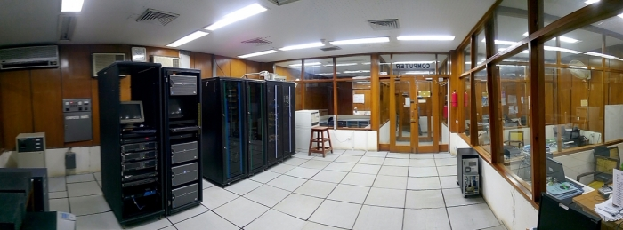
ABOUT ICPC
Central point/ Backbone for Digital connectivity.
Provides Internet and Telephone / Intercom Services.
High Speed Internet i.e 312 Mbps.
Private telephone exchange EPABX.

Slide 3
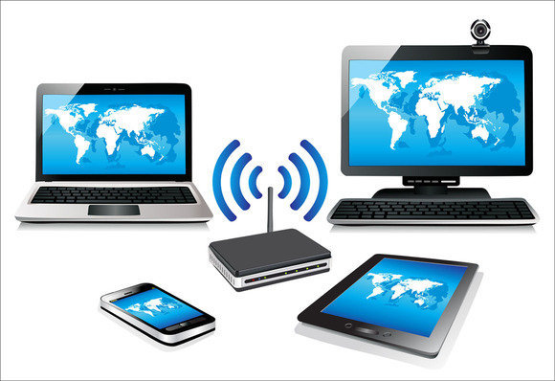
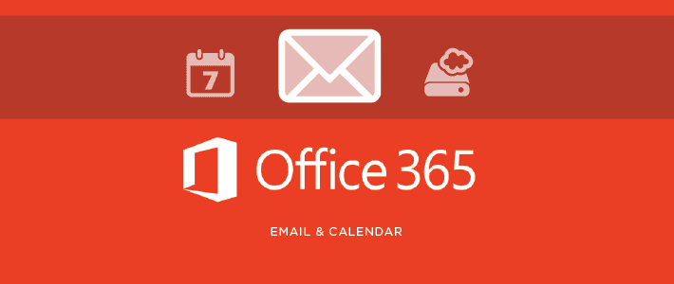
LIST OF ICPC Services
Data & Voice Network Services
Wired/Wireless Internet Connectivity
SMS Alert Service
Web Services (LMS, MUET Website)
MUET Official Email Account
Internet Access Account
VPN Service
Microsoft Dream Spark Account
Training related to Digital Services
Smart ID Card

Slide 4
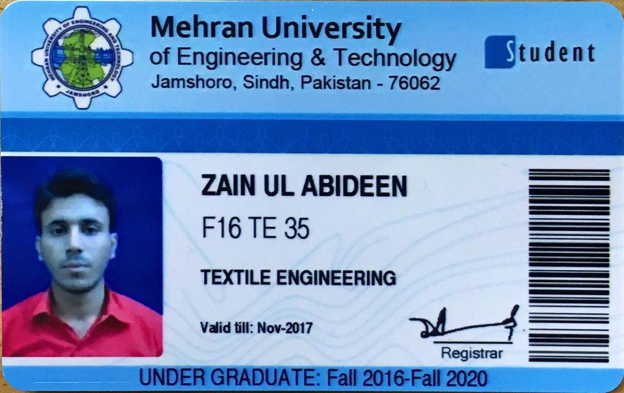
MUET Smart ID Card
Official identity card for employees and students.
It is obligatory to wear and carry this Card.

Slide 5
Applying For
Smart ID Card
Internet Access / VPN Account
MUET Official Email Account

Slide 6
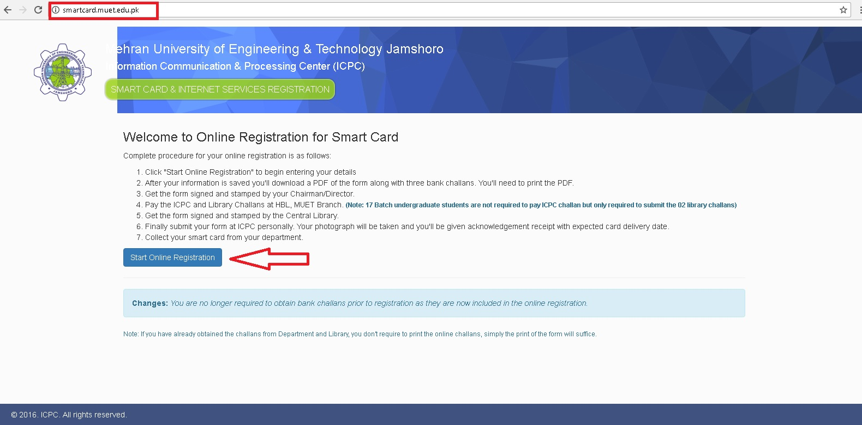
STEP NO. 01 (OPEN THE SITE)
Please open the web browser (e.g. Google Chrome, Mozilla Firefox or Internet explorer) and type the “smartcard.muet.edu.pk” web address in the URL bar:

Slide 7
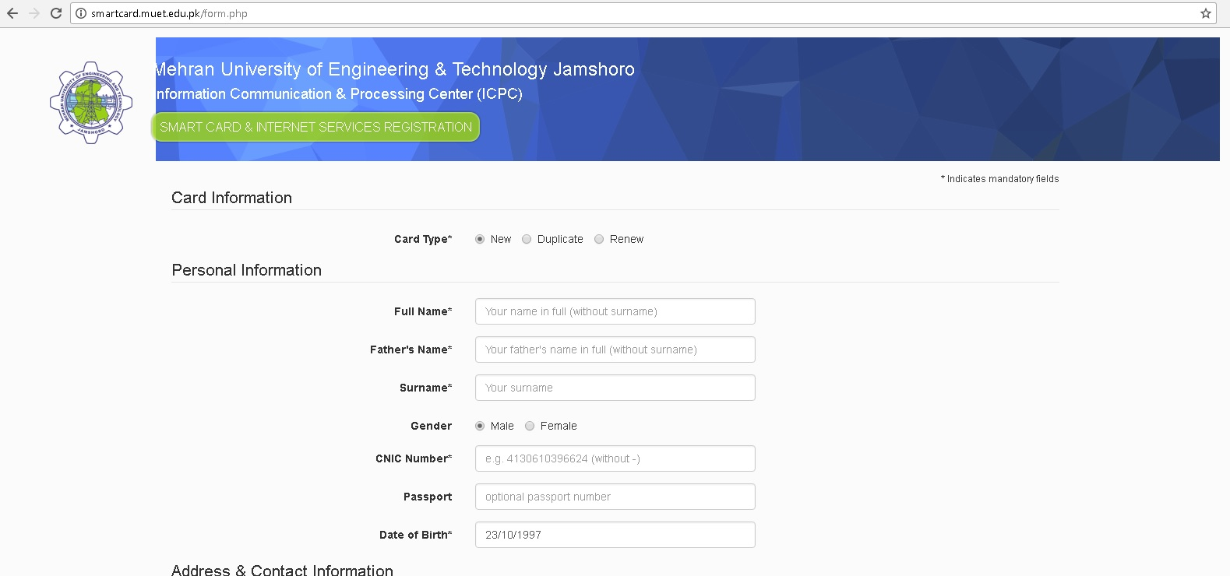
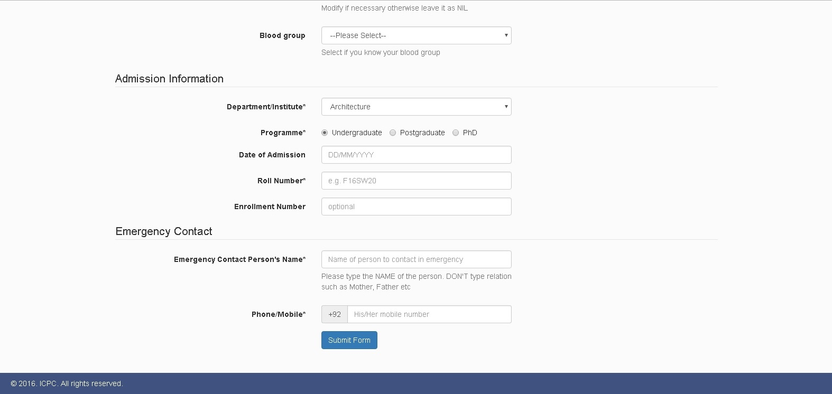
STEP NO. 02: FILLING & SUBMITTING FORM
Click on Submit

Slide 8
STEP NO. 03: DOWNLOAD THE FORM
NOTE:
PLEASE KEEP THE SOFT COPY OF THE FORM SAFE IN YOUR DEVICE (PC/LAPTOP OR SMARTPHONE) IT MAY BE REQUIRED IN FUTURE FOR ANY CORRESPONDENCE

Slide 9
STEP NO. 04: PRINT THE FORM
After downloading, locate the form and get it printed and complete the “3 Steps” (the required signatures i-e:- Student Sign, Chairman Sign and Library Sign).
After completing the requirements visit ICPC Smart Card Cell for finalizing card registration.
Chairman Sign with Stamp
Library Sign with Stamp

Slide 10
STEP NO. 05: VISIT TO I.C.P.C
After processing you will have to visit ICPC in person along with Smart ID Card Registration form and photocopy of Admission letter.

Slide 11
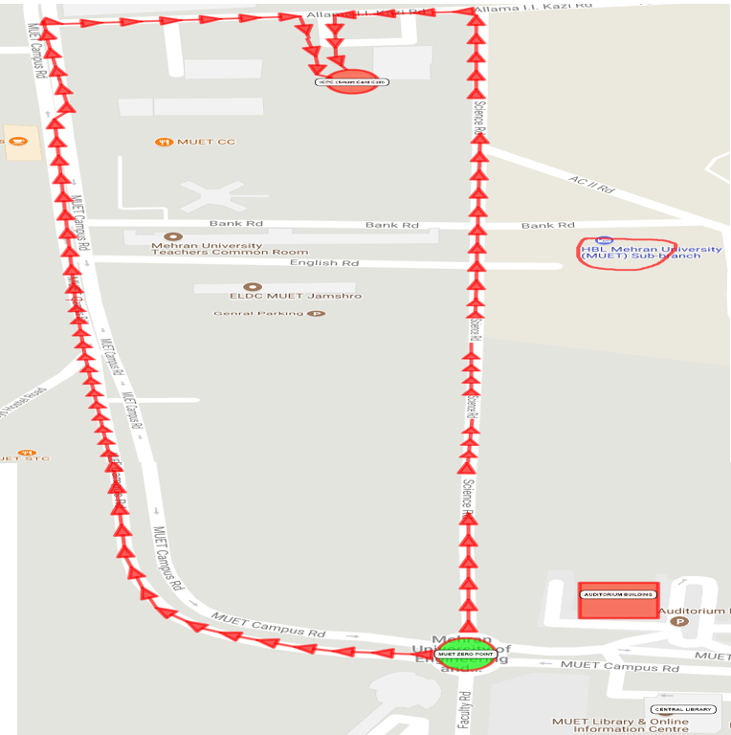
I.C.P.C
HBL Bank
AUDITORIUM
ZERO POINT
MUET LIBRARY

Slide 12
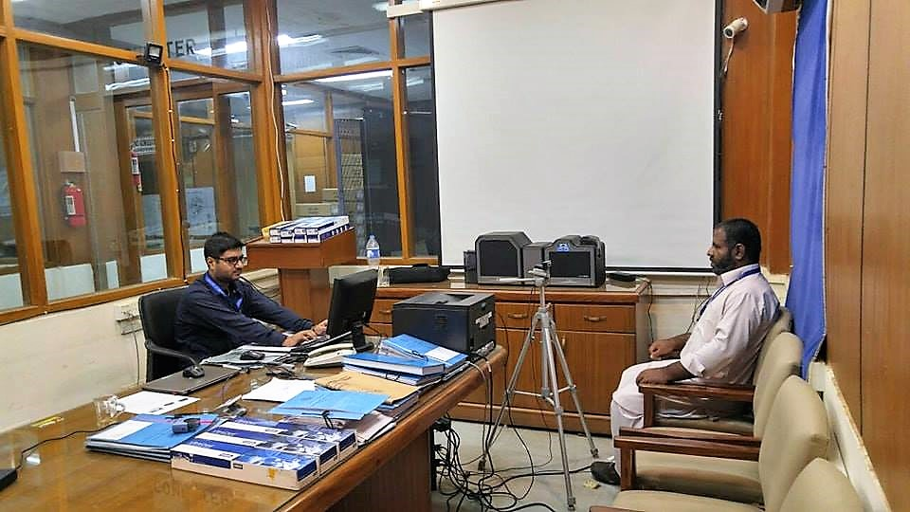
SMART CARD CELL
01
Please give your form to the person sitting in front of the PC/Computer
Please be seated and wait until concerned students Name is called
When students are called they should sit in the chair before the blue Curtain for the photo capturing
Please do not forget to collect the RECEIPT of your form submission
02

Slide 13
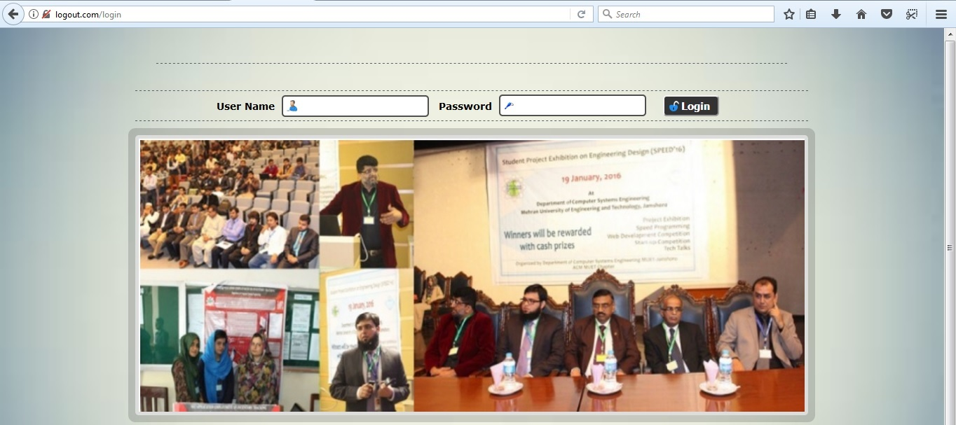
Internet Access / VPN Account
After the process of Smart ID Card
Internet Access Account will be sent through SMS.

Slide 14
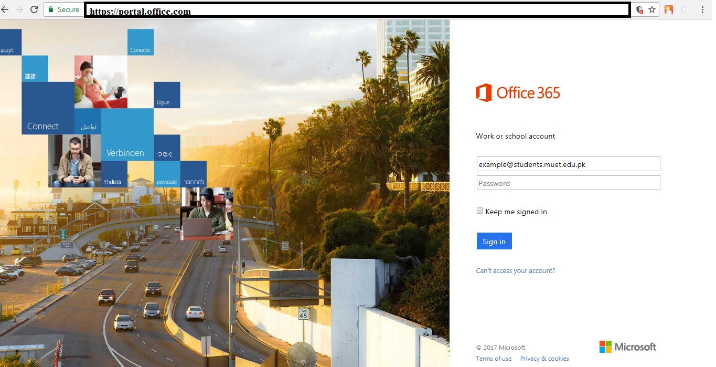
MUET Official Email Account
example@students.muet.edu.pk for Official Communication.
Login Link: https://www.portal.office.com

Slide 15
THANK YOU

